Slide 1
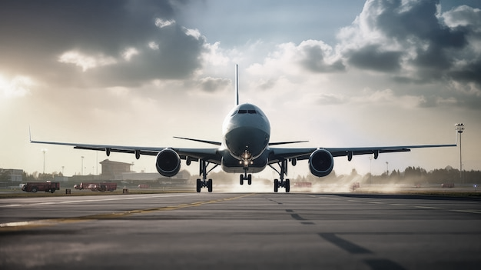
Flying prices

Slide 2
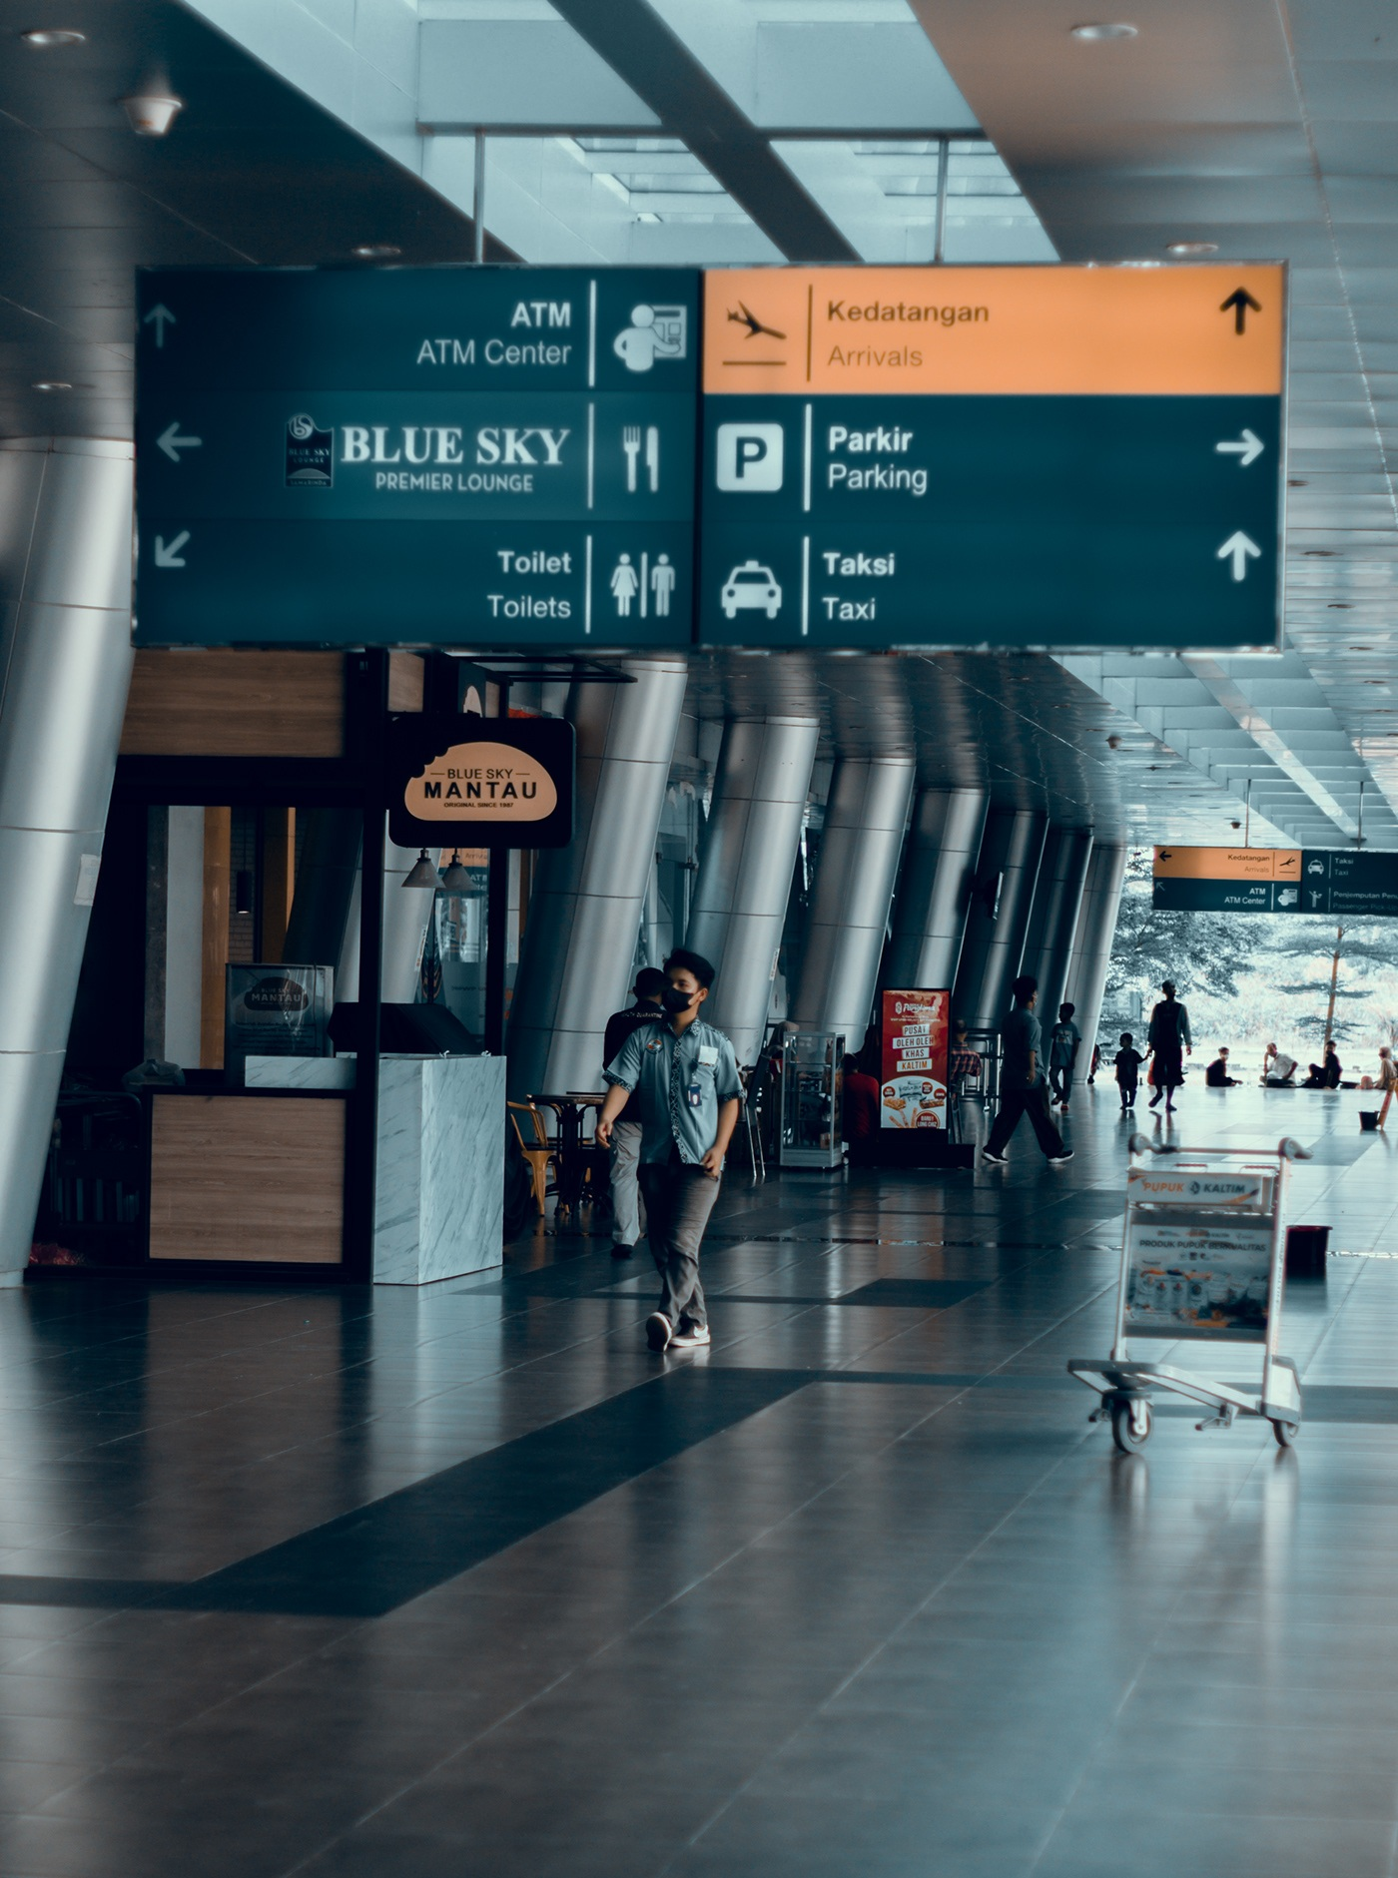
AGENDA
Introduction
Statement of Problem
The aim
Analysis of the data
Conclusion

Slide 3

Introduction
Traveling is one of most requesting things and people travel for several purposes like working, studying and visiting. One of travel challenging points is the price.
In this presentation we will spotlight the factor affecting flight prices.

Slide 4
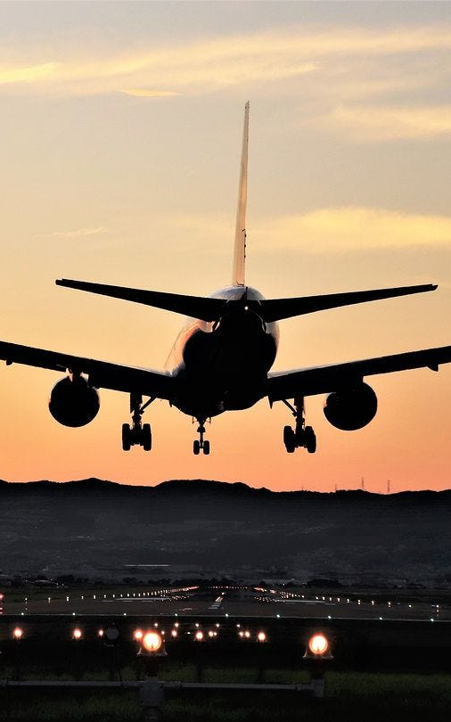
Statement of Problem
Despite significant variations in flight prices, it is still unclear how individual factors such as airlines, travel class, travel duration, number of stops, and day of the week contribute to these price differences. Without a clear understanding of the relative impact of these variables, travelers and decision makers lack the insights needed to make informed decisions.

Slide 5
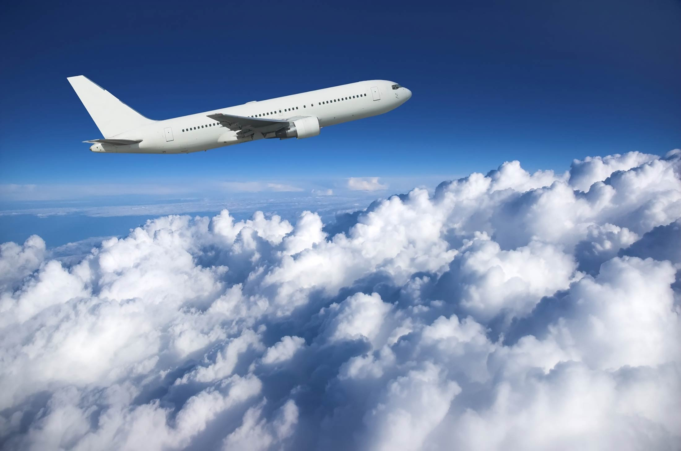
The Aim
The aim of this project is to understand how different factors like the airlines, travel class, number of stops, and day of the week affect flight prices. By analyzing these factors, we aim to help travelers and decision makers to make the best decisions.

Slide 6


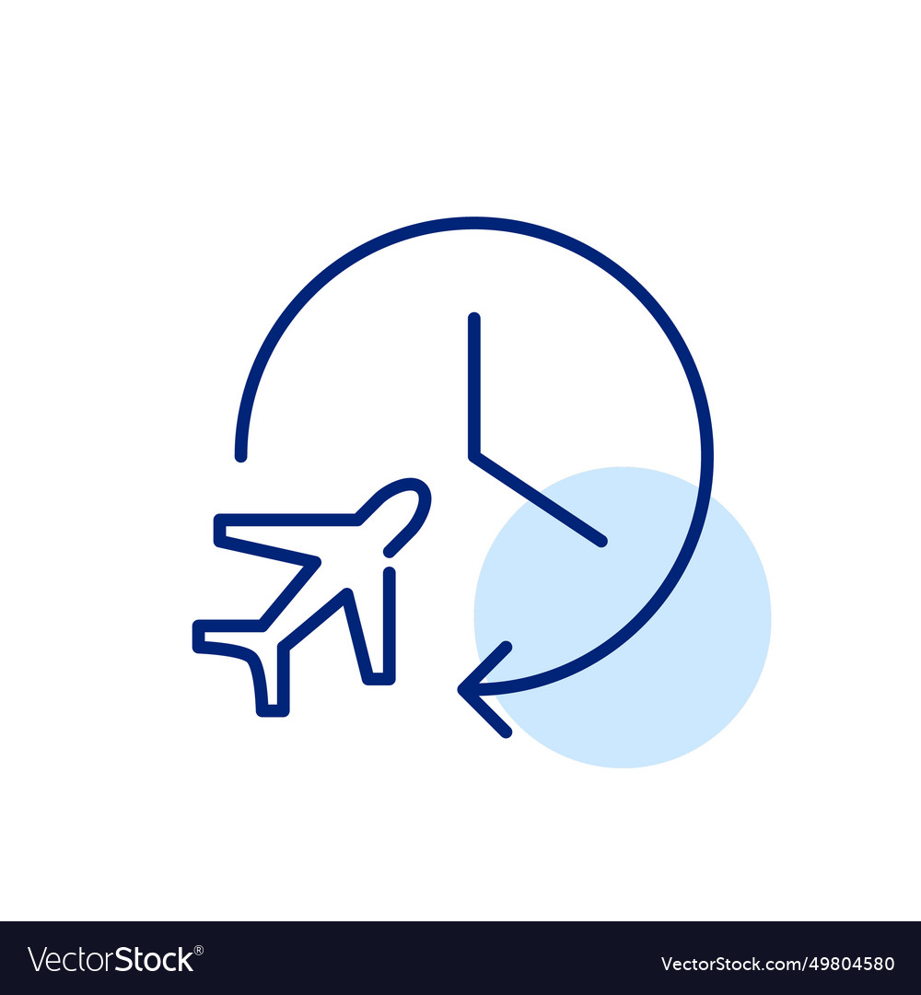
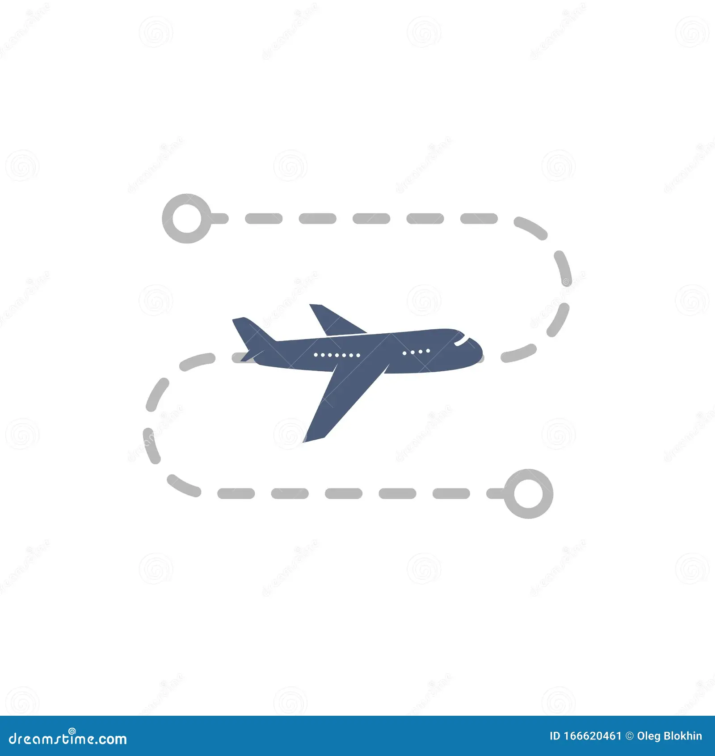


Analysis of the data
One-way US domestic flights in 2022
Time
Airlines
Duration
Distance
Stops
Cabin Class
Dataset link: https://www.kaggle.com/datasets/dilwong/flightprices/data

Slide 7
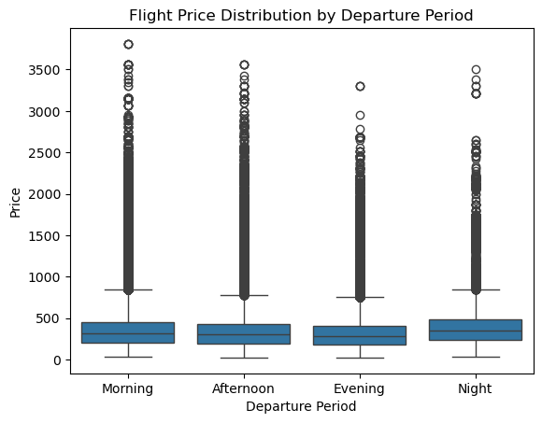
Do flight prices vary depending on the periods of the day (morning, afternoon, evening, night)?
1. Time
Departure Period | Mean | Median
Evening | 329.09416 | 278.6
Afternoon | 341.3113 | 300.71
Morning | 354.89985 | 317.6
Night | 379.43515 | 354.01

Slide 8
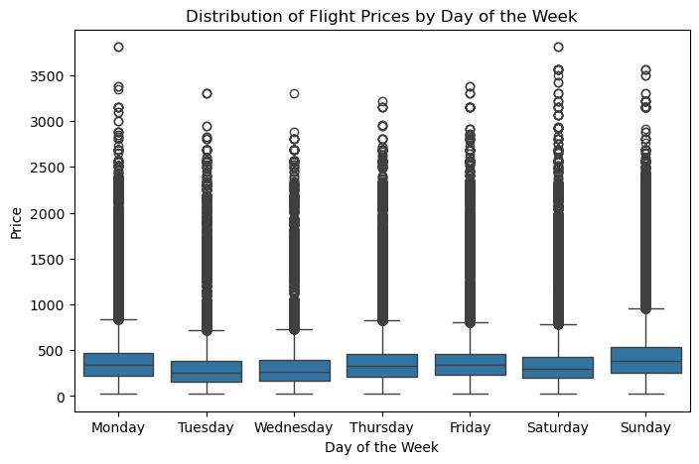
Do flight prices vary depending on the day of the week?
1. Time
Flight Date | Mean | Median
Tuesday | 294.17013 | 248.6
Wednesday | 302.89228 | 262.61
Saturday | 344.42736 | 297.1
Thursday | 361.85558 | 326.6
Monday | 368.62629 | 336.1
Friday | 370.49098 | 335.58
Sunday | 429.35428 | 378.6

Slide 9
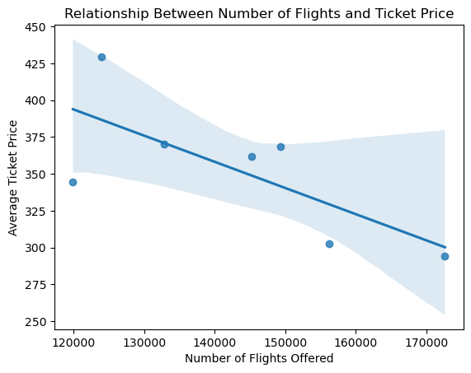
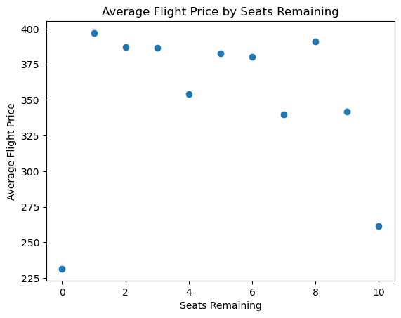
Are ticket prices affected by seats remaining or number of flights offered on a given day?
Correlation = - 0.6 (notable)
Correlation = -0.008 (Weak)

Slide 10



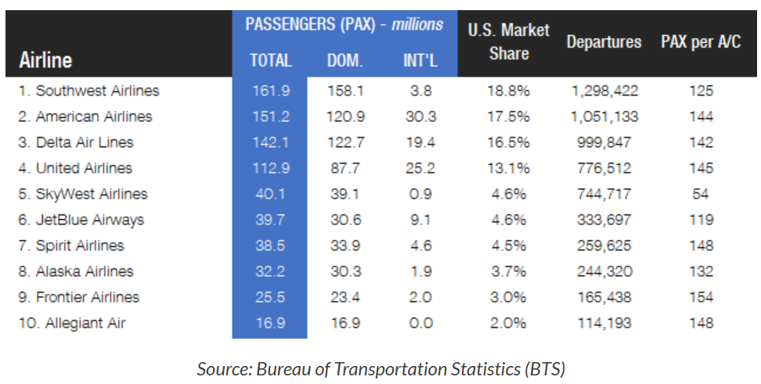
2. Airlines
https://flightplan.forecastinternational.com/2023/09/26/top-100-airlines-in-the-us 2022/#:~:text=In%202022%2C%20the%20%231%20airline%20by%20passengers%20was,Lines%20in%20third%20place%20with%20142.1%20million%20%2816.5%25%29.

Slide 11
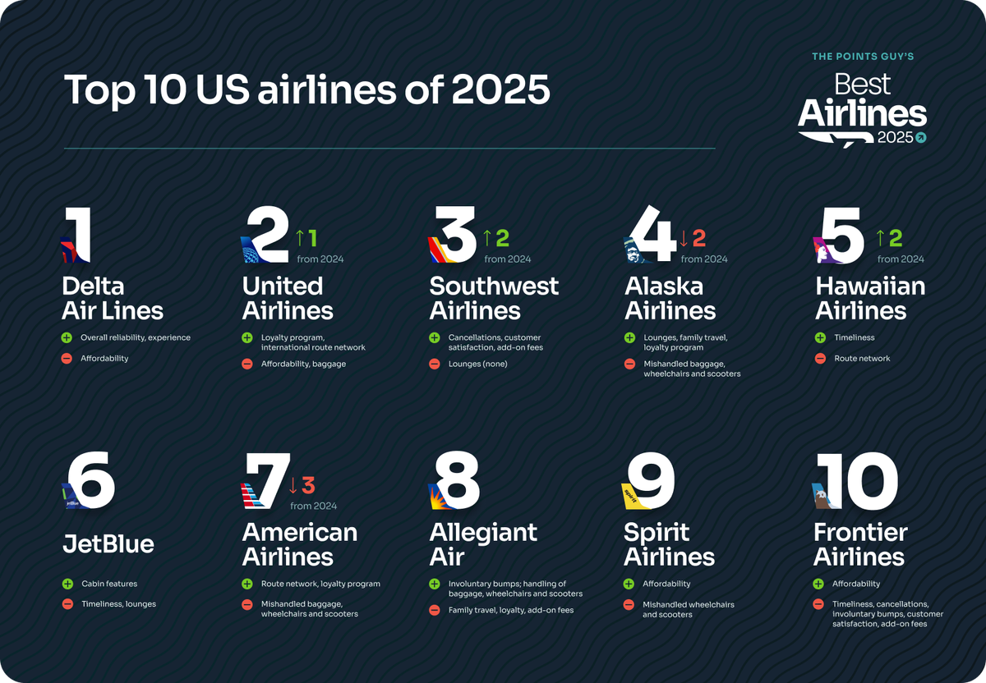
https://thepointsguy.com/airline/best-us-airlines-2025

Slide 12
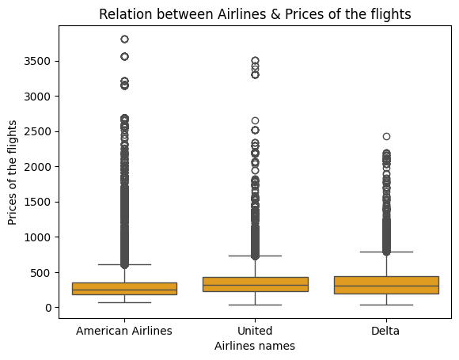

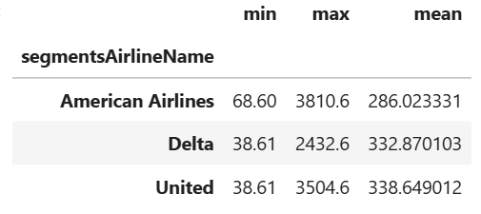

Airlines
Is there a difference between airline prices?
But the difference isn’t big

Slide 13
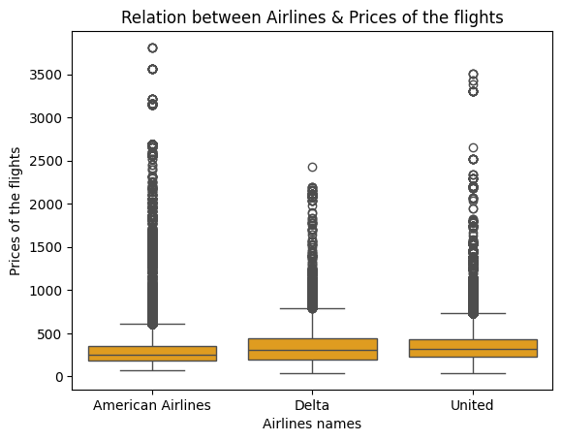
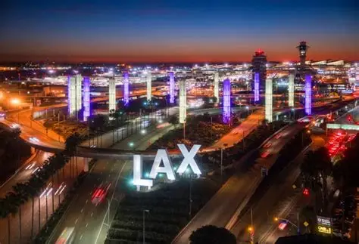
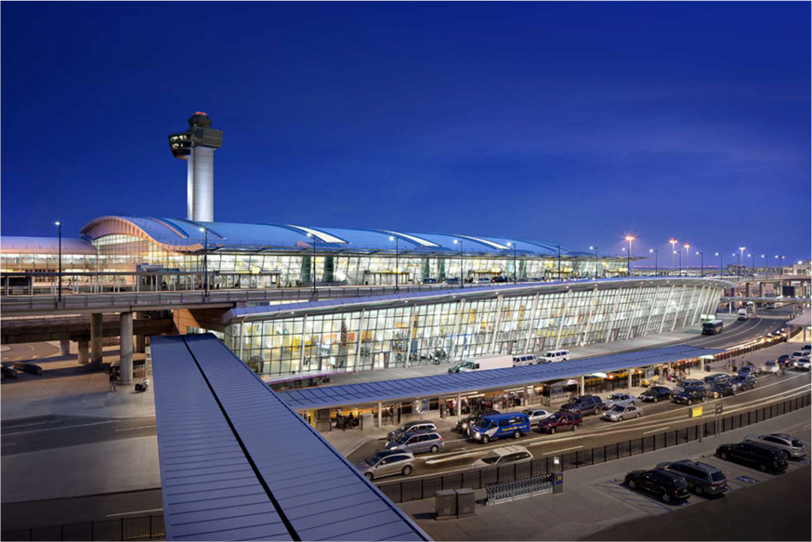
Airlines
Highest price
Is there a difference between airline prices?
But the difference isn’t big

Slide 14
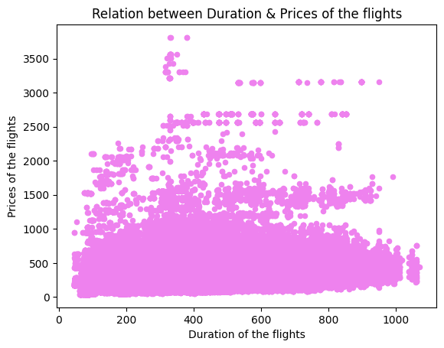

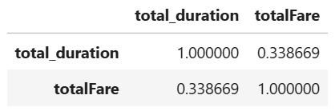
3. Duration
Does the flight duration affect the prices?
Thers is positive relation

Slide 15
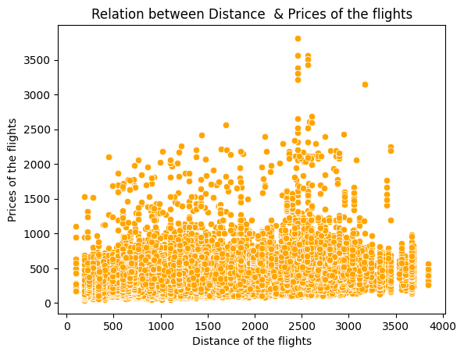

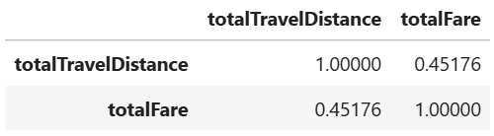
4. Distance
Does the flight distance affect the prices?
Thers is positive relation

Slide 16
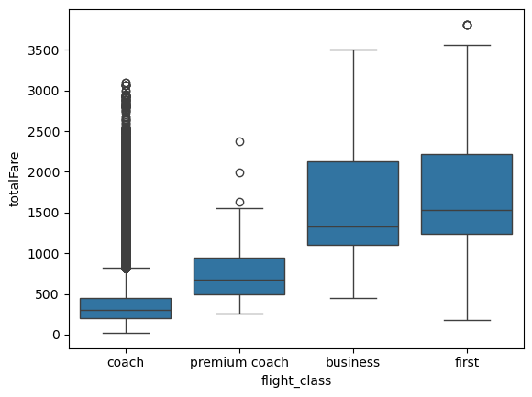
5. Cabin Class
How Cabin Class Affects Flight Price?

Slide 17
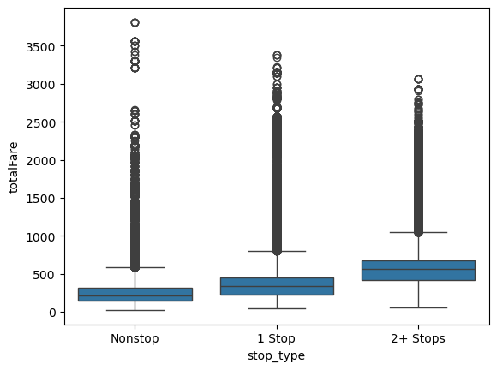
6. Stops
Number of Stops vs Price

Slide 18
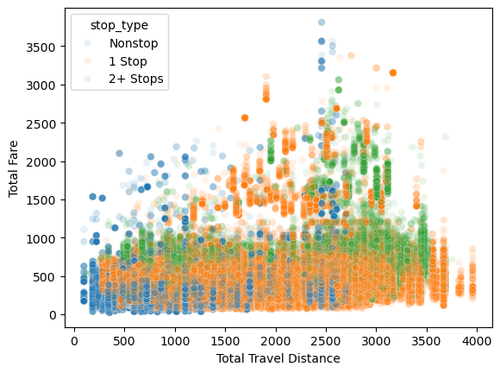
6. Stops
Impact of Stop Type and Travel Distance on price

Slide 19
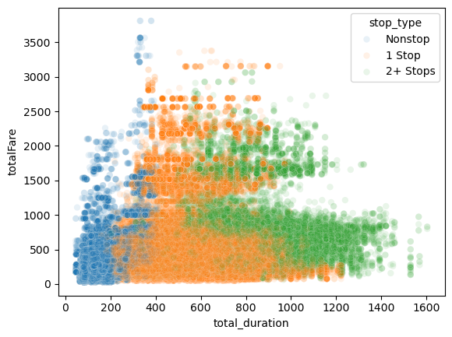
6. Stops
Impact of Stop Type and Travel Duration on price

Slide 20

Conclusion
Flight prices are shaped by multiple factors, including time of day, airlines, number of stops, distance, duration, and travel class. Understanding these dynamics can help travelers make smarter booking decisions and enable airlines to optimize pricing strategies more effectively.

Slide 21

Thank you

